Slide 1
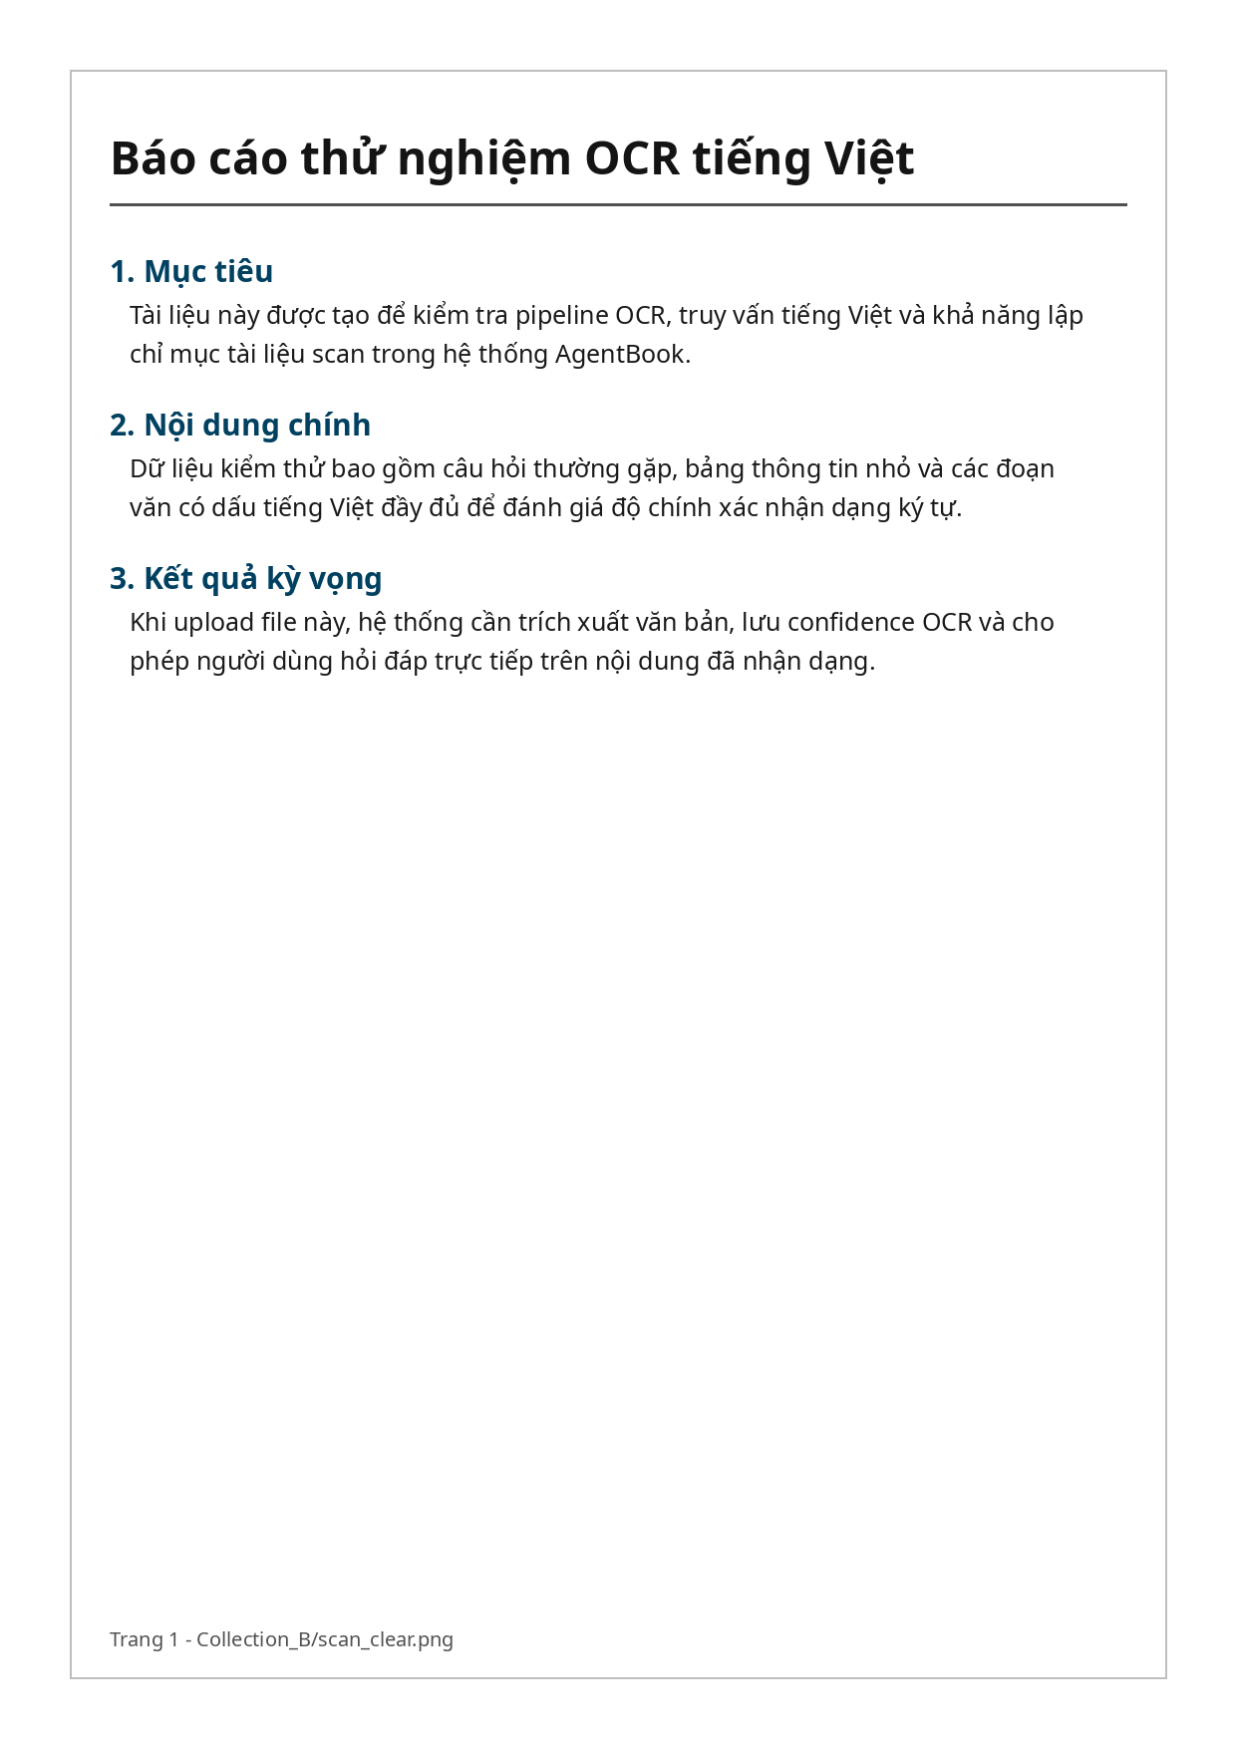
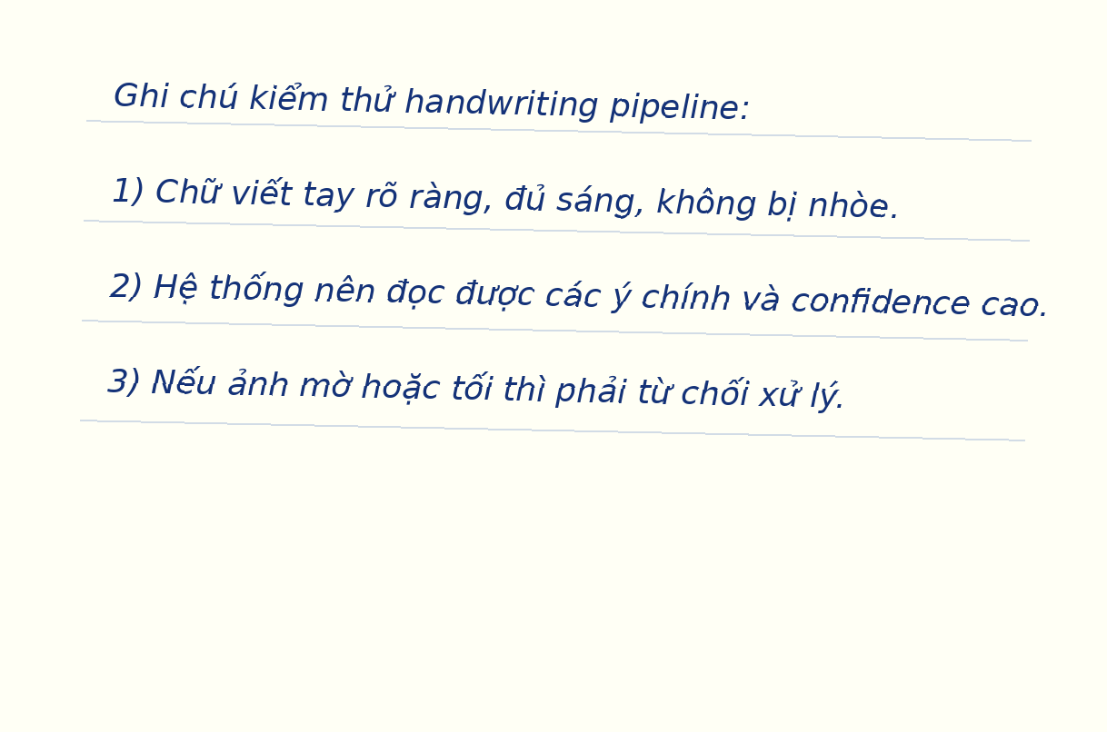
AgentBook
Mixed-Modality Test Deck
Synthetic slides for parser routing, figure captioning, chart extraction, and RAG testing.
AgentBook test deck | 1/10

Slide 2
1. System overview
The pipeline normalizes diverse materials into searchable blocks.
Upload material
→
Parser router
→
Block builder
→
Vector index
→
Query agents
Debug should expose parser name, modality, chunk count, and qdrant_vector_count.
Design principle: fail loudly on poor input; never index unreliable text silently.
AgentBook test deck | 2/10

Slide 3
2. Parser router
Each extension should activate the intended parser branch.
Input Parser Expected block
PDF text Docling text/table/figure
PDF scan Docling + OCR ocr_text
DOCX Docling + python-docx table
PPTX FigureCaptioner figure
CSV/XLSX SpreadsheetParser table_block
MP3/WAV AudioParser audio_segment
Question to test: “Which parser handles image-only Vietnamese PDFs?”
Expected answer: the scan path uses Docling plus an OCR fallback, then persists OCR confidence for debug inspection.
This slide intentionally combines a table and explanatory text.
AgentBook test deck | 3/10

Slide 4
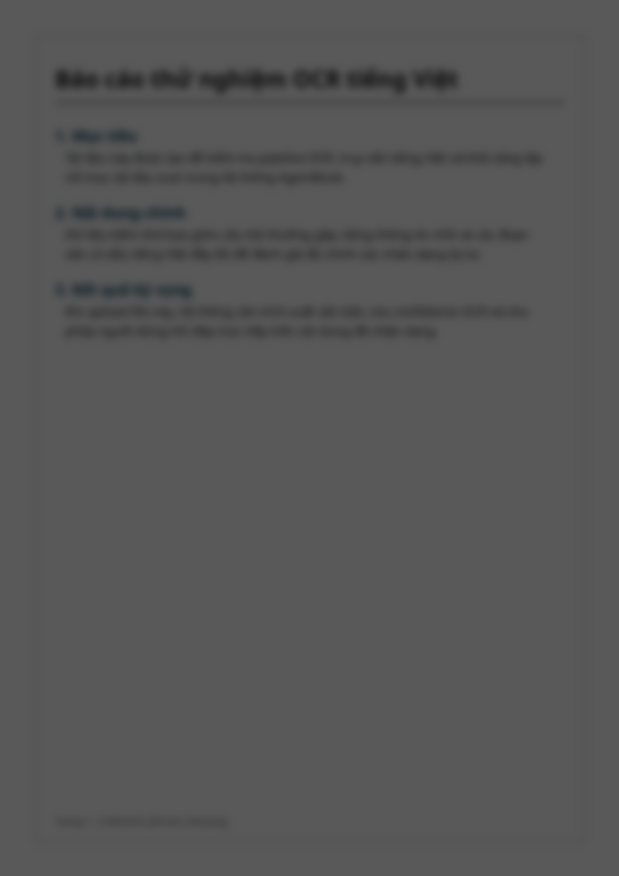
3. OCR quality gate
The same OCR pipeline must pass clear scans and reject poor ones.
Quality fields to inspect: blur variance, brightness, contrast, skew angle, and OCR confidence.
Strong policy: refusing low-quality input is a feature, not a bug. Bad OCR poisons the vector database.
FAIL
blur/dark
PASS
clear text
AgentBook test deck | 4/10

Slide 5
4. Spreadsheet and table retrieval
Tables should preserve row context and sheet names.
Product Category Price Rating
iPhone 15 Pro Phone 29M 4.8
MacBook Air M3 Laptop 28M 4.7
Sony XM5 Headphone 8.5M 4.8
Keychron K2 Accessory 2.1M 4.4
Example question: “Sản phẩm nào có giá cao nhất?” Expected row: Asus ROG Zephyrus or iPhone depending on source table used.
Debug target: block_type table + block_kind table_block for CSV/XLSX.
AgentBook test deck | 5/10

Slide 6
5. Cross-lingual RAG
Vietnamese questions should retrieve English evidence and answer in Vietnamese.
Câu hỏi tiếng Việt
→
English evidence
→
Vietnamese answer
The evaluation is not translation quality alone. The real test is whether retrieval remains stable across languages.
A weak pipeline answers fluently but loses evidence. A strong pipeline retrieves first, then verbalizes in the user language.
AgentBook test deck | 6/10

Slide 7
6. Study-guide endpoint
Summaries explain; study guides teach.
Learning objectives
Key concepts
Glossary
Review questions
Mini quiz
Common pitfalls
The best study-guide output should preserve source grounding while changing the form into a learner-friendly structure.
Quick check: ask for five quiz questions from lecture_notes.pdf and verify each answer is traceable to a source chunk.
AgentBook test deck | 7/10

Slide 8
7. Compare endpoint
Comparison should find overlap, not just surface-level similarity.
lecture_notes.pdf
Conceptual flow
comparison_doc.docx
Tables + risks
shared evidence
Shared claims
Parser, OCR, RAG, debug
Expected result: list shared facts, PDF-only details, DOCX-only details, and practical contradictions if any.
AgentBook test deck | 8/10

Slide 9
8. GraphRAG ask-graph
Entities and relationships make corpus-level questions possible.
AgentBook
↙ ↓ ↘
Parser Router
Query Agent
Vector Index
↘
↙
OCR Gate
Study Guide
Graph extraction should connect components, endpoints, and expected debug signals.
AgentBook test deck | 9/10

Slide 10

9. End-to-end checklist
A compact smoke test before deeper evaluation.
✓ Upload all Collection_A files into Test_Collection_A.
✓ Upload all Collection_B files into Test_Collection_B.
✓ Confirm qdrant_vector_count > 0 for indexed materials.
✓ Ask Vietnamese questions over English PDF.
Blurry image = expected refusal.
✓ Compare PDF and DOCX on the same topic.
✓ Validate OCR pass and refusal behavior.
✓ Run table retrieval on CSV/XLSX.
✓ Transcribe the short Vietnamese audio sample.
AgentBook test deck | 10/10

